Slide 1

COMPUTER NETWORKS
Sivaraman Eswaran Ph.D.
Department of Computer Science and Engineering

Slide 2

COMPUTER NETWORKS
Application Layer
Sivaraman Eswaran Ph.D.
Department of Computer Science and Engineering

Slide 3
COMPUTER NETWORKS
Unit – 2 Application Layer
2.1 Principles of Network Applications
2.2 Web, HTTP and HTTPS
2.3 The Domain Name System
2.4 P2P Applications
2.5 Socket Programming with TCP & UDP
2.6 Other Application Layer Protocols

Slide 4
COMPUTER NETWORKS
Web, HTTP and HTTPS
First, a quick review…
web page consists of objects, each of which can be stored on different Web servers
object can be HTML file, JPEG image, Java applet, audio file,…
web page consists of base HTML-file which includes several referenced objects, each addressable by a URL, e.g.,
If a Web page contains HTML text and 5 JPEG images, then the Web page has 6 objects: the base HTML file plus the 5 images.
www.someschool.edu/someDept/pic.gif
host name
path name

Slide 5


COMPUTER NETWORKS
HTTP Overview
HTTP: hypertext transfer protocol
Web’s application layer protocol
client/server model:
client: browser that requests, receives, (using HTTP protocol) and “displays” Web objects
server: Web server sends (using HTTP protocol) objects in response to requests
HTTP request
PC running
Firefox browser
HTTP response
HTTP request
server running
Apache/IIS Web
server
HTTP response
iPhone running
Safari browser
Defined in RFC 1945; RFC 2616

Slide 6
COMPUTER NETWORKS
HTTP Overview (more)
HTTP uses TCP:
client initiates TCP connection (creates socket) to server, port 80
server accepts TCP connection from client
HTTP messages (application-layer protocol messages) exchanged between browser (HTTP client) and Web server (HTTP server)
TCP connection closed
HTTP is “stateless”
server maintains no information about past client requests
aside
protocols that maintain “state” are complex!
past history (state) must be maintained
if server/client crashes, their views of “state” may be inconsistent, must be reconciled

Slide 7
COMPUTER NETWORKS
HTTP Connections: two types
Non-persistent HTTP
TCP connection opened
at most one object sent over TCP connection
TCP connection closed
downloading multiple objects required multiple connections
Persistent HTTP
TCP connection opened to a server
multiple objects can be sent over single TCP connection between client, and that server
TCP connection closed

Slide 8
COMPUTER NETWORKS
Non-persistent HTTP: example
User enters URL:
www.someSchool.edu/someDepartment/home.index
(base HTML file containing text, references to 10 jpeg images)
1b. HTTP server at host www.someSchool.edu waiting for TCP connection at port 80 “accepts” connection, notifying client
1a. HTTP client initiates TCP connection to HTTP server (process) at www.someSchool.edu on port 80
2. HTTP client sends HTTP request message (containing URL) into TCP connection socket. Message indicates that client wants object someDepartment/home.index
3. HTTP server receives request message, forms response message containing requested object, and sends message into its socket
time

Slide 9
COMPUTER NETWORKS
Non-persistent HTTP: example (more)
User enters URL:
www.someSchool.edu/someDepartment/home.index
(containing text, references to 10 jpeg images)
4. HTTP server closes TCP connection.
5. HTTP client receives response message containing html file, displays html. Parsing html file, finds 10 referenced jpeg objects
6. Steps 1-5 repeated for each of 10 jpeg objects
time

Slide 10
COMPUTER NETWORKS
Non-persistent HTTP: response time
RTT (definition): time for a small packet to travel from client to server and back
HTTP response time (per object):
one RTT to initiate TCP connection
one RTT for HTTP request and first few bytes of HTTP response to return
obect/file transmission time
initiate TCP
connection
RTT
request file
RTT
time to
transmit
file
file received
time
time
Non-persistent HTTP response time = 2RTT+ file transmission time

Slide 11
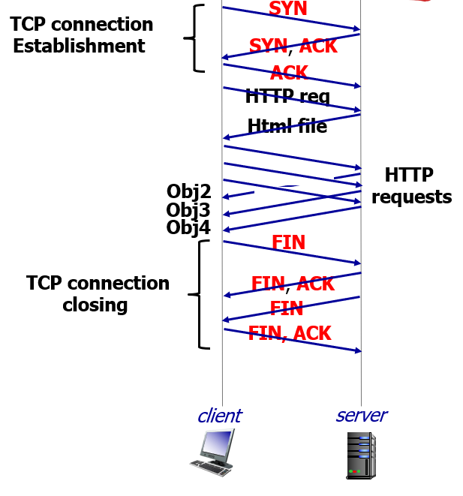
COMPUTER NETWORKS
Persistent HTTP (HTTP 1.1)
Non-persistent HTTP issues:
requires 2 RTTs per object
OS overhead for each TCP connection (TCP buffer and variables)
browsers often open multiple parallel TCP connections to fetch referenced objects in parallel
Persistent HTTP (HTTP1.1):
server leaves connection open after sending response
subsequent HTTP messages between same client/server sent over open connection
client sends requests as soon as it encounters a referenced object
as little as one RTT for all the referenced objects (cutting response time in half)

Slide 12
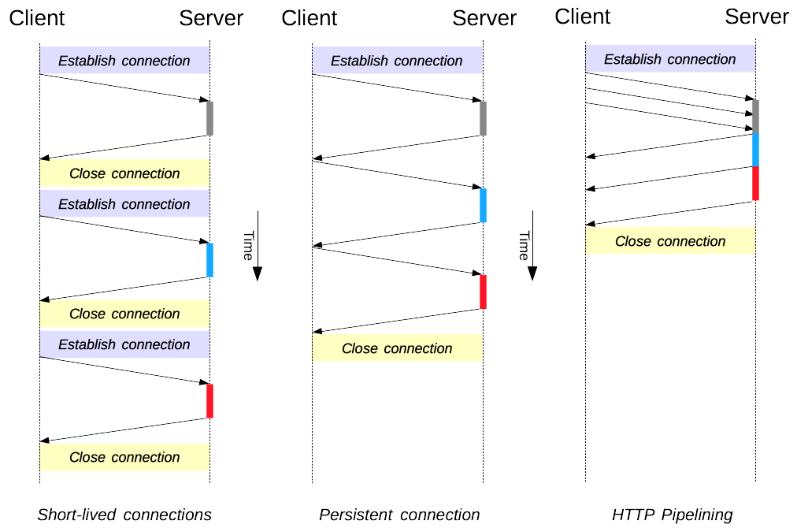
COMPUTER NETWORKS
Connection Management in HTTP/1.x

Slide 13
THANK YOU
Sivaraman Eswaran Ph.D.
Department of Computer Science and Engineering
sivaramane@pes.edu
+91 80 6666 3333 Extn 834

